Slide 1
The unreasonable effectiveness of Recurrent Neural Networks
Author: Andrej Karpathy
Blog published at May 21, 2015

Slide 2
Outline
What is a RNN?
How do they work?
Some examples of Character-Level Language Models
Future perspectives

Slide 3
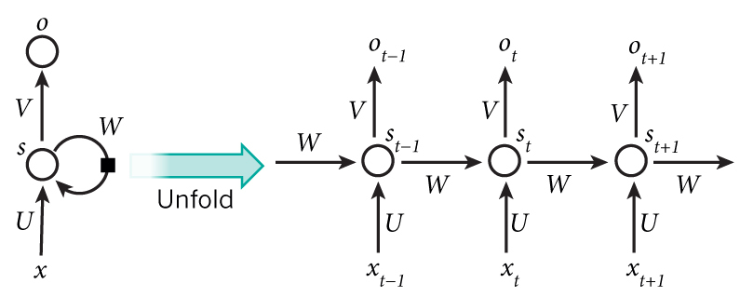




What is a RNN?
$$x_{t}:Input at time step t$$
$$s_{t}:Memory of the network$$
$$s_{t}=f(Ux_{t}+Ws_{t−1})$$
$$o_{t}:Output at the step t$$

Slide 4
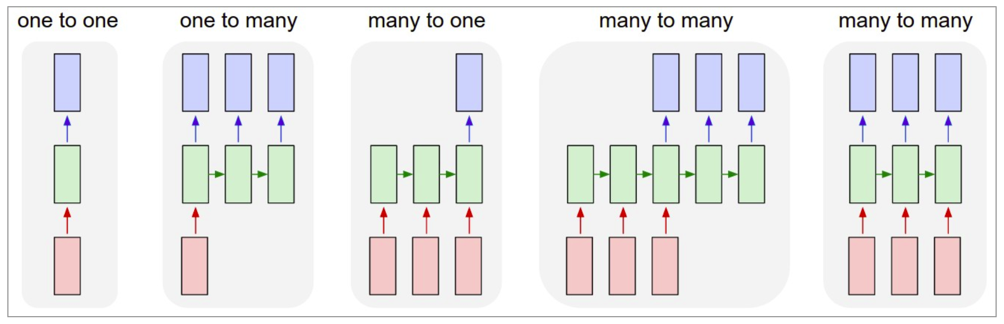
How do they work?

Slide 5
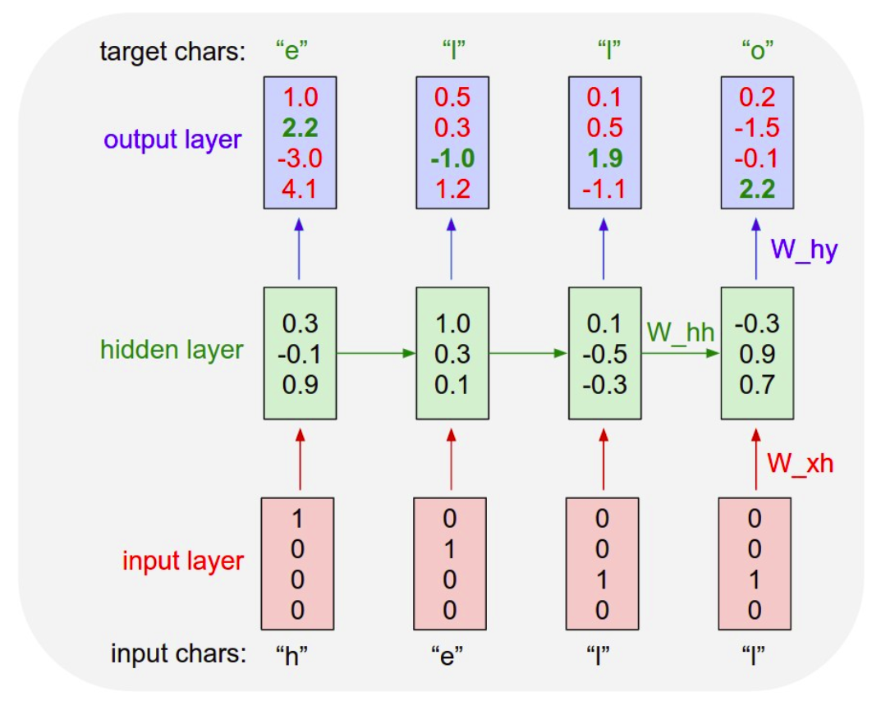
How do they work?

Slide 6
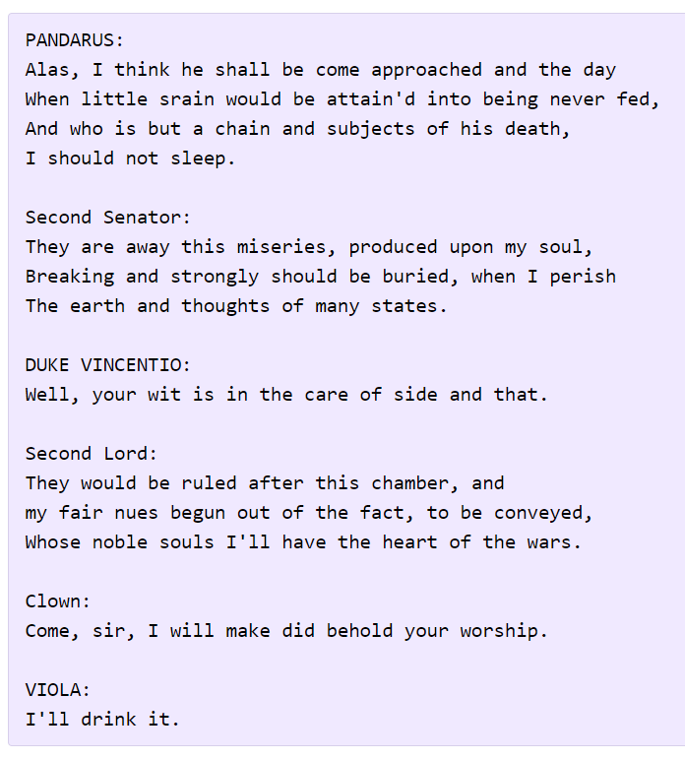
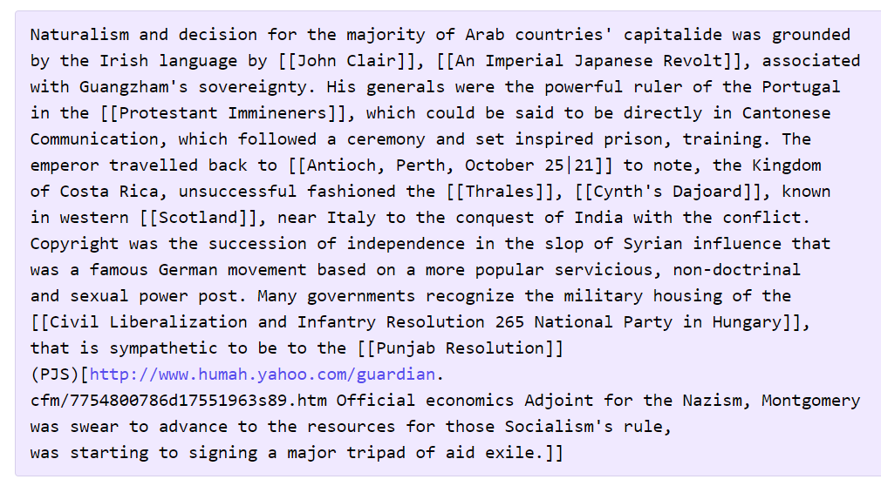
Character-Level Language Models
Shakespeare
Wikipedia
RNN applied
3-layer RNN
~512 hidden nodes per layer
LSTM
(Long-short term memory)

Slide 7
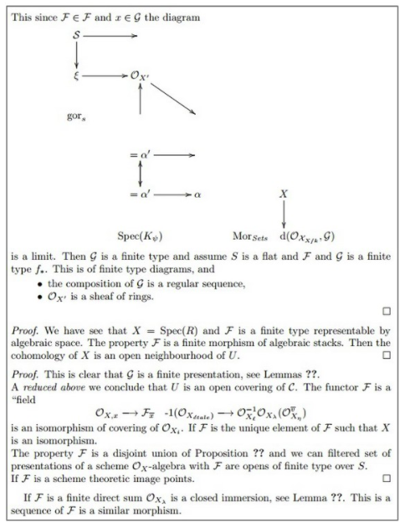
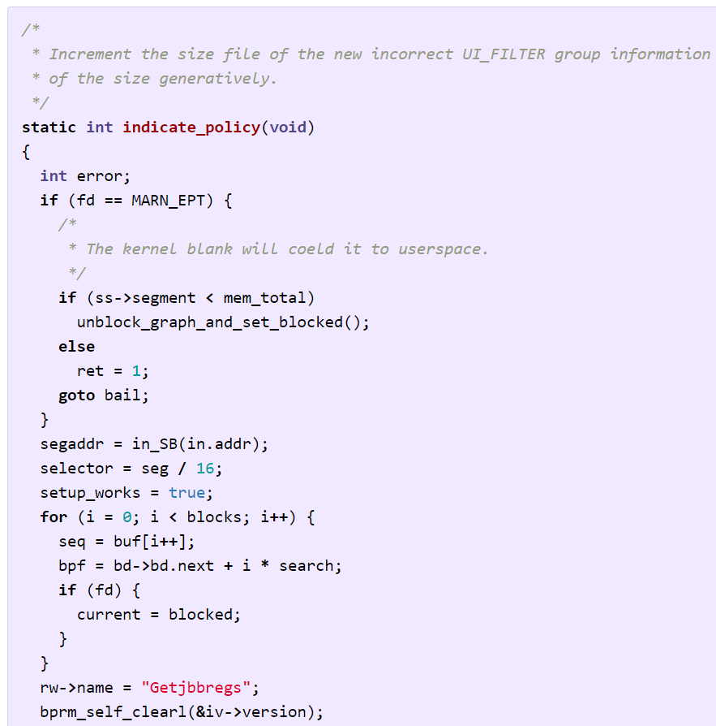
Character-Level Language Models
Algebraic geometry (latex)
Linux source code

